Slide 1
HOW TO BE AN INTELLECTUAL

Slide 2
Law is one of the most intellectually challenging subjects you can study at university.

Slide 3
Studying Law requires you to be able to think critically about the society you live in.

Slide 4
To do that, your mind needs to be equipped with a hinterland of ideas and knowledge that you can draw on to think about what sort of society we live in, and what sort of society it would be good to live in.

Slide 5
Too many students lack that kind of hinterland.

Slide 6
This presentation is about why this is, and what can be done about it.

Slide 7
There are three obstacles in the way of students acquiring the kind of hinterland I am talking about.

Slide 8
(1) The problem of exams. (2) The problem of time. (3) The problem of volume.

Slide 9
Let’s take the problem of exams first.

Slide 10
It’s obvious that how you do in your exams is extremely important nowadays.

Slide 11
There are various reasons for this, including...

Slide 12
... increasing competition for valuable opportunities...

Slide 13
... and an increasing unwillingness among those in charge of those opportunities to exercise their judgment to see who should be awarded those opportunities.

Slide 14
That same surrender of judgment to ‘objective standards’ of achievement also operates among the exam boards.

Slide 15
Instead of judging whether an essay written by a student in History or English is good or bad, instead the exam board is more comfortable...

Slide 16
...giving the essay a mark determined by whether the essay is written with a certain structure, and whether the essay hits certain points.

Slide 17
But preparing to do well in exams that are marked like that will not help you become an intellectual.

Slide 18
Quite the opposite.

Slide 19
Writing essays to a plan that the exam board wants you to write before you will get a high mark is the opposite of what an intellectual would do.

Slide 20
The problem of exams means that we now live in the moral equivalent of the Soviet Union. (Not a good thing.)

Slide 21
Intellectual students have to lead a double life.

Slide 22
A public life where they play by the rules and do what they need to do to get high marks in the all-important exams.

Slide 23
(And they should do this – I’m not discouraging that at all given how important it is to your future that you do well in exams.)

Slide 24
And a private life where they get to read interesting, exciting books.

Slide 25
Should their private life leak out into their public life, disaster will ensue – at least in their exams. Bad grades will follow.

Slide 26
Ian McEwan’s son was reading McEwan’s novel Enduring Love for A-Level.

Slide 27
McEwan gave his son some help with an essay the son was writing on his dad’s novel.

Slide 28
The son’s essay got a C+. (The Times, May 7 2018)

Slide 29
Lesson: if you don’t conform, and say exactly what the exam boards want you to say, you will get a bad mark.

Slide 30
This is a profoundly anti-intellectual stance.

Slide 31
So intellectual school children have to keep their heads down, and hope that one day – at university – they will be allowed to express themselves.

Slide 32
But many more children learn not to be intellectuals.

Slide 33
They read what they need to read (and no more than that) and write exactly what they need to write (and no more than that).

Slide 34
And when they get to university, they struggle.

Slide 35
They expect to be spoon-fed the answers, and resent being expected to think for themselves.

Slide 36
And the more they struggle, the more anxious and depressed they become.

Slide 37
It’s not their fault. The problem of exams mean that they are ill-equipped for university life.

Slide 38
The real fault lies in the growing standardisation of society...

Slide 39
... where your place in society is determined by ‘objective standards’ that make sure that everything is fair and square...

Slide 40
... and no one can complain that they have been treated unfairly.

Slide 41
But the obsession with fairness has its costs, and one of them is the harm it does to young students’ abilities to be intellectuals.

Slide 42
But it’s not just the problem of exams that creates an obstacle to students’ being able to be intellectual.

Slide 43
There is also the problem of time.

Slide 44
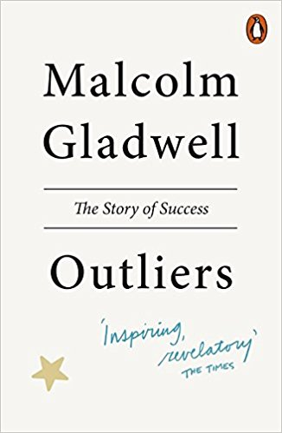
Malcolm Gladwell’s book Outliers is about the reasons why some people are incredibly successful, while others are not.

Slide 45
He points out that all of the founders of the personal computer revolution were born in 1954 or 1955.

Slide 46
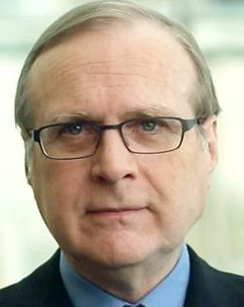
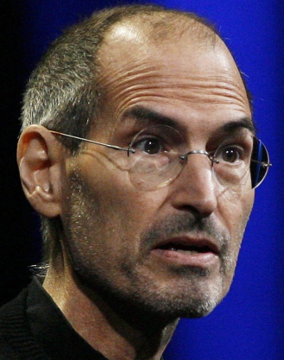
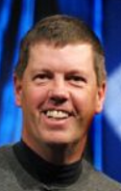
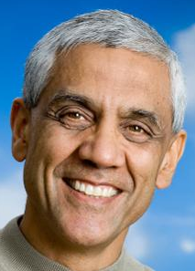
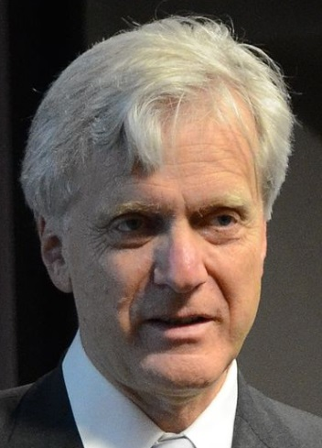
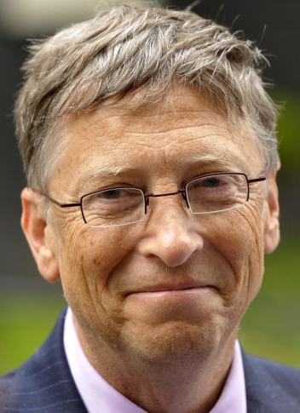
Bill Joy, co-founder of Sun Microsystems
November 8 1954
Paul Allen, co-founder of Microsoft
January 21, 1955
Steve Jobs, co-founder of Apple
February 24, 1955
Scott McNealy, co-founder of Sun Microsystems
November 13, 1954
Vinod Khosla, co-founder of Sun Microsystems
January 28, 1955
Eric Schmidt, co-founder of Google
April 27, 1955
Andy Bechtholsheim,
co-founder of Sun Microsystems
September 30, 1955
Bill Gates, co-founder of Microsoft
October 28, 1955

Slide 47
The secret of their success is, in part, the fact that they were all born at the right time.

Slide 48
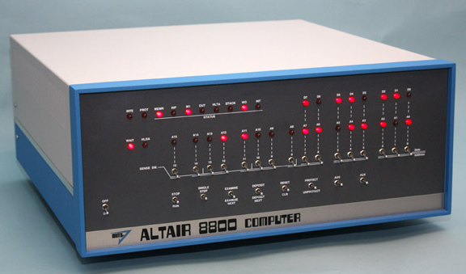
They were all 20 or 21 when the first ever home assembly personal computer (the Altair 8800) was launched in January 1975.

Slide 49
They were therefore ideally placed – just starting out in their careers, no commitments – to play a leading role in the revolution to come.

Slide 50
In the same way, I think it is harder for a student who was born in (say) 2001 to be an intellectual than it is for me, who was born in 1970.

Slide 51
For example, to be an intellectual you have to have a good understanding of the history of your country, and the world.

Slide 52
Here is a timeline of the most politically important years from 1901 to the present day.

Slide 53
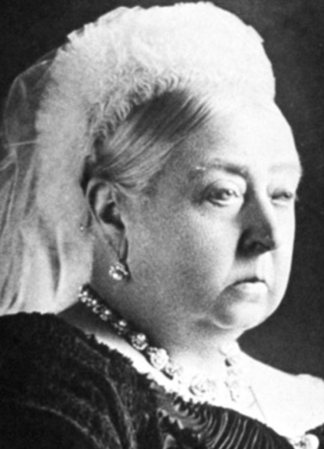
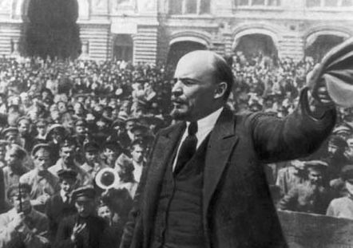
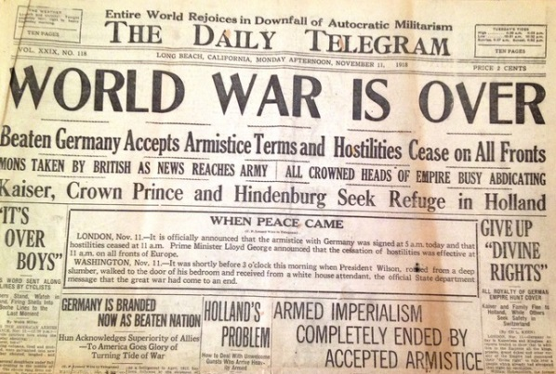
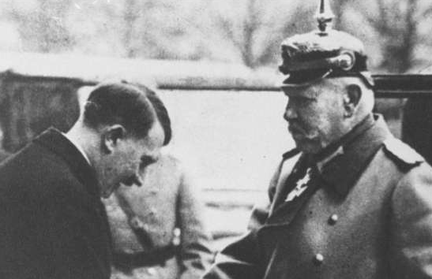
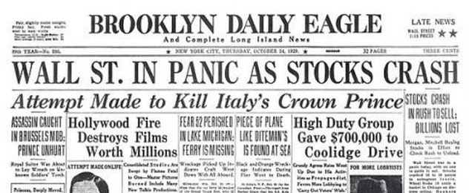
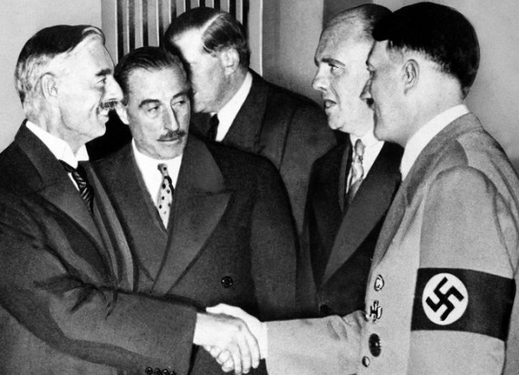
1914
Outbreak of World War I
1917
Russian Revolution
1901
Death of Queen Victoria
1918
End of World War I
1933
Hitler elected German Chancellor
1929
Wall Street crash on Black Tuesday triggers Great Depression
1938
Munich pact

Slide 54
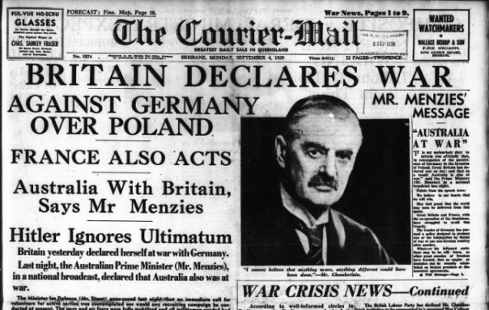
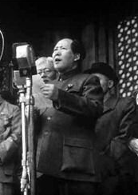
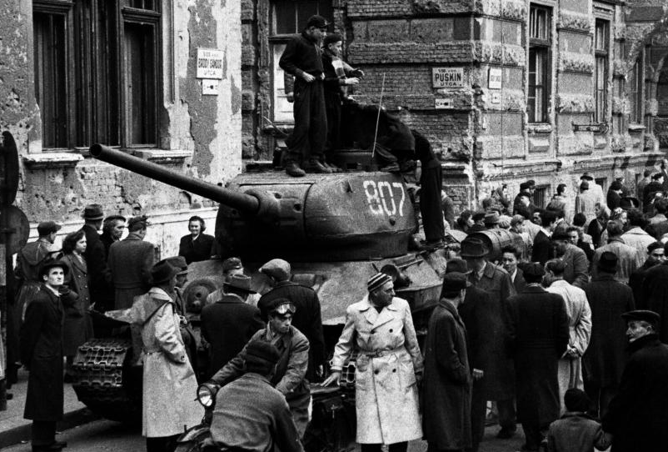
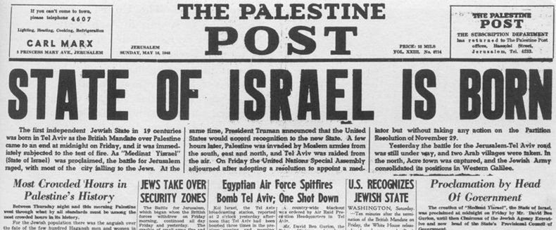
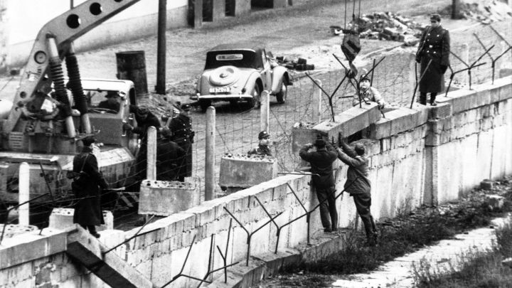
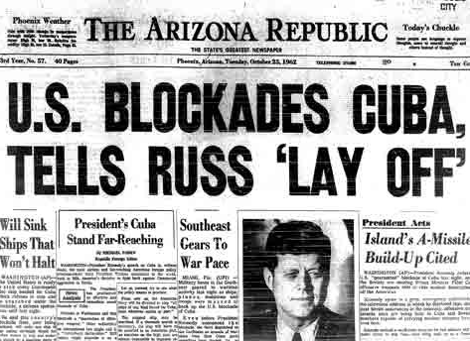
1939
Outbreak of World War II
1941
Entry of USA into World War II
1945
End of World War II
1948
Communist takeover of China; founding of modern State of Israel
1956
Hungarian uprising
against communist rule
1961
Erection of Berlin Wall
1962
Cuban Missile Crisis

Slide 55
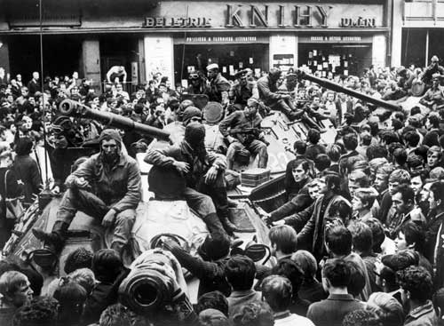
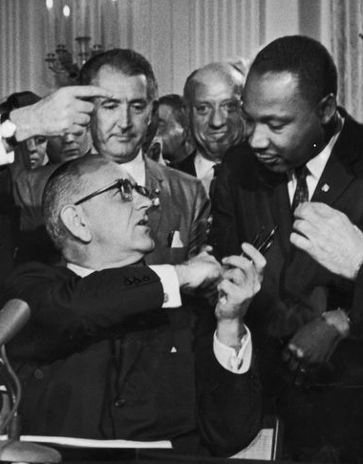
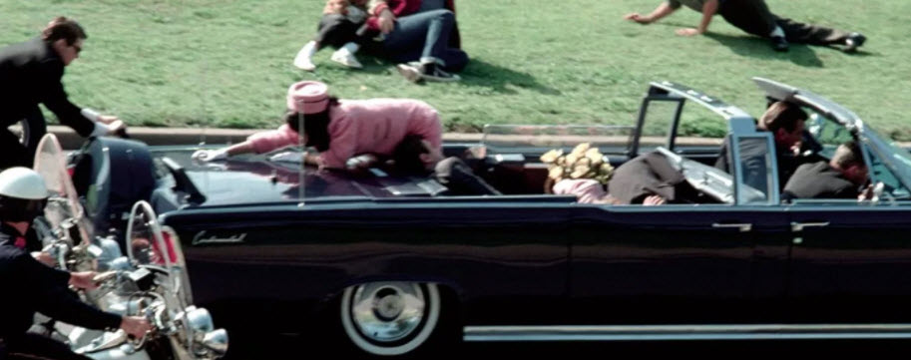
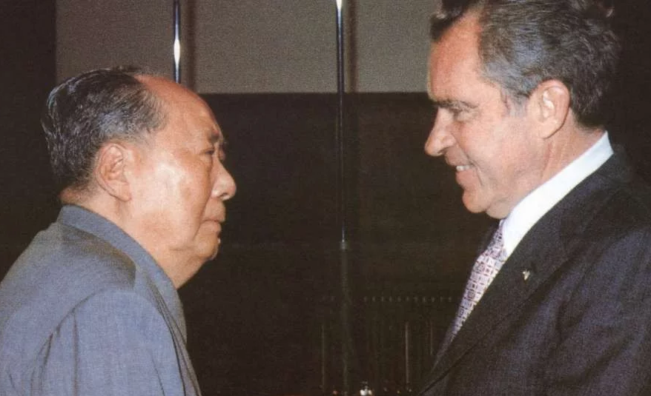
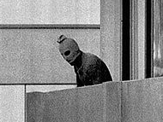
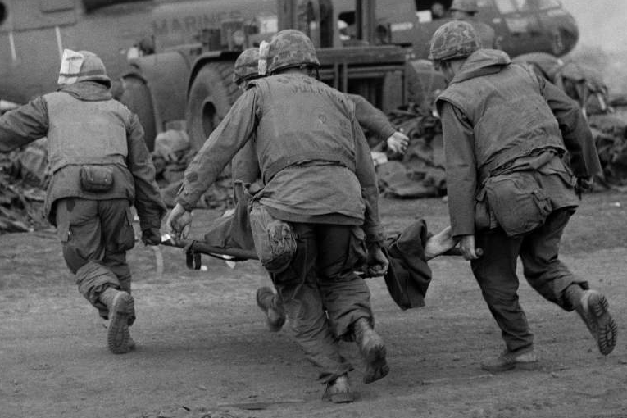
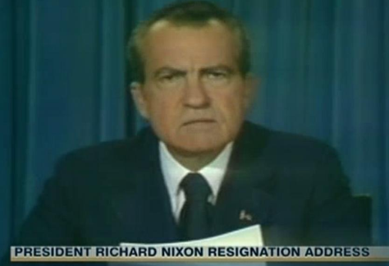
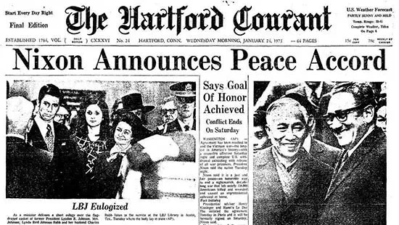
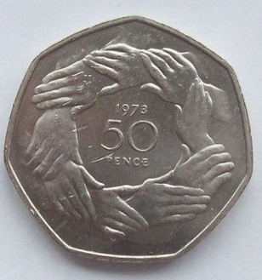
1963
Assassination of President Kennedy
1964
Passing of Civil Rights Act
1968
Prague Spring uprising against communist rule;
Tet Offensive in Vietnam War
1972
President Nixon visit to China; massacre at Munich Olympics
1973
End of
Vietnam War;
entry of UK
into EEC
1974
Nixon resigns over Watergate

Slide 56
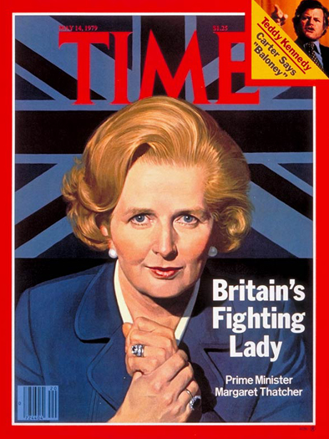
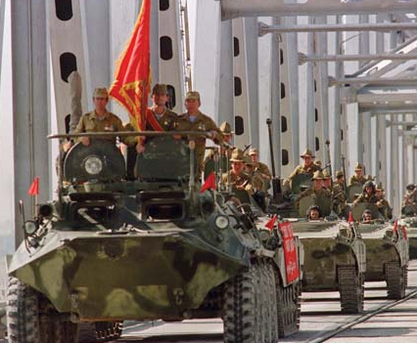
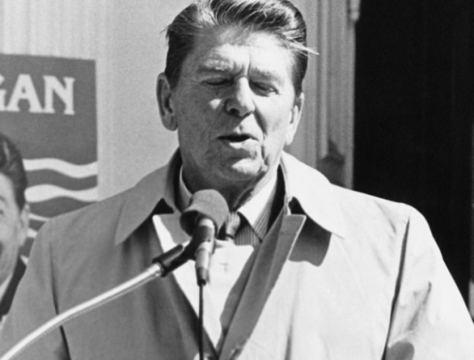
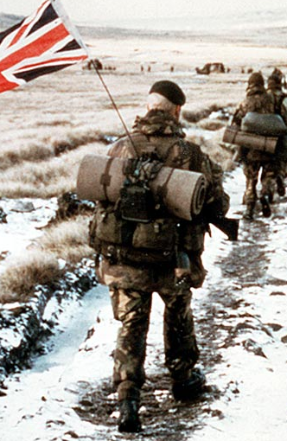
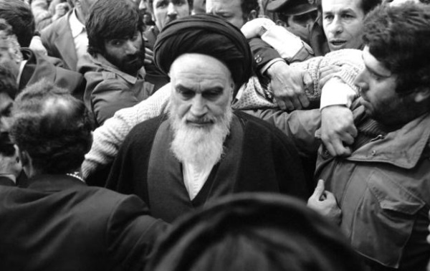
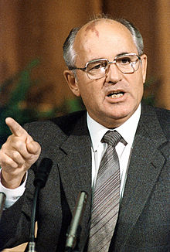
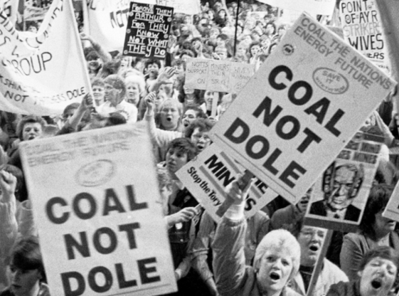
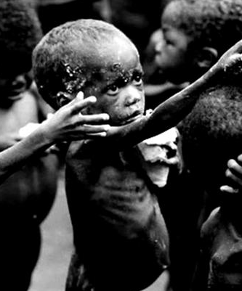
1980
Election of Ronald Reagan as President
1979
Election of Margaret Thatcher as PM; Soviet invasion of Afghanistan; overthrow of Shah of Iran.
1982
Falklands War
1989
Fall of Berlin Wall
1984
Miners’ strike; famine in Ethiopia
1985
Mikhail Gorbachev becomes General Secretary of Communist Party of Soviet Union

Slide 57
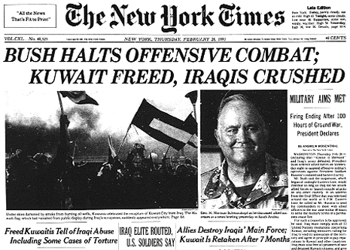
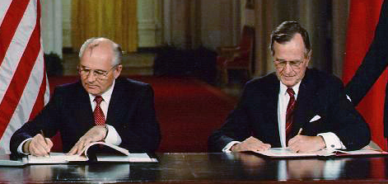
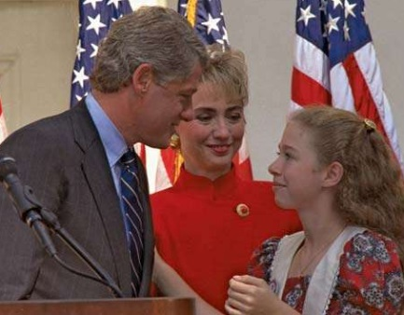
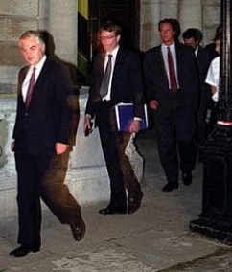
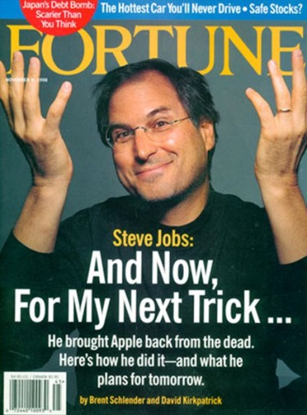
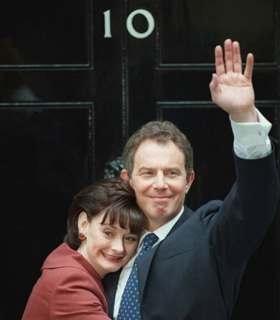
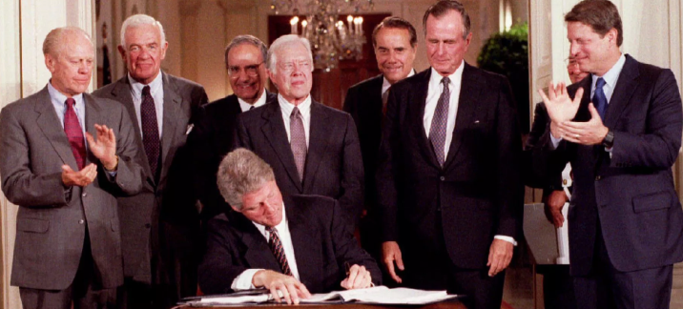
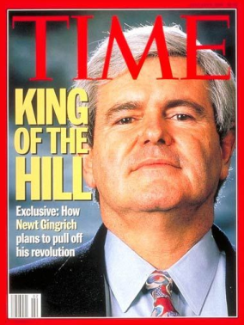
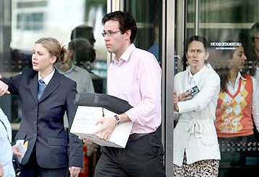
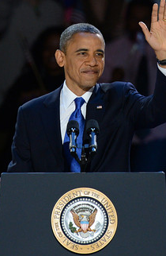
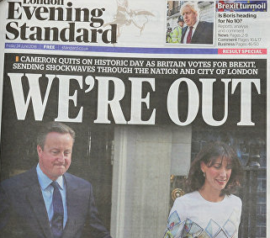
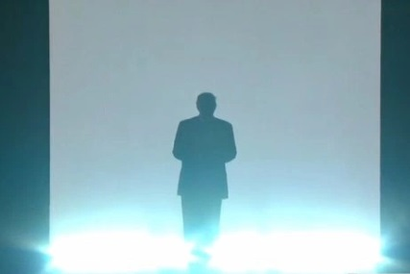
1990
Iraq invades Kuwait;
Gulf War ensues
1991
End of Cold War;
dissolution of Soviet Union
1992
Election of Bill Clinton as President; UK exit from ERM
2001
9/11
1994
USA enters into
NAFTA; Republicans assume control of Congress for
the first time
in 40 years
1997
Tony Blair elected PM;
Steve Jobs returns to Apple
2016
Brexit referendum; election of Donald Trump as President
2008
Worldwide economic crisis; election of Barack Obama as President
2003
Invasion of Iraq

Slide 58
Let’s arrange those dates in a table.

Slide 59
1901 1939 1963 1980 1992 1914 1941 1964 1982 1994 1917 1945 1968 1984 1997 1918 1948 1972 1985 2001 1929 1956 1973 1989 2003 1933 1961 1974 1990 2008 1938 1962 1979 1991 2016

Slide 60
Notice how someone born in 1970 (like me) falls into the middle of the table.

Slide 61
So to understand the history of my times, I didn’t have to know much about what happened before I was born, and could live through the rest.

Slide 62
Whereas someone born in 2001 has to learn much more about what happened before they were born. And they only have eight years (from age 10 to 18) to do it.

Slide 63
It would be amazing if they succeeded.

Slide 64
The result is that I am in a much better position to understand events such as the political revolutions of 2016 than someone born in 2001.

Slide 65
I can link those events to other events that I lived through. Someone born in 2001 will have had to have learned about these other events to know about them.

Slide 66
1990
Iraq invades Kuwait;
Gulf War ensues
1991
End of Cold War;
dissolution of Soviet Union
1992
Election of Bill Clinton as President; UK exit from ERM
2001
9/11
1994
USA enters into
NAFTA; Republicans assume control of Congress for
the first time
in 40 years
1997
Tony Blair elected PM;
Steve Jobs returns to Apple
2016
Brexit referendum; election of Donald Trump as President
2008
Worldwide economic crisis; election of Barack Obama as President
2003
Invasion of Iraq

Slide 67
It would be amazing if they were able to do this.

Slide 68
This is the problem of time.

Slide 69
If you were born in 2001, and want to be an intellectual by age 18, you have about eight years to master a huge amount of information about what happened before you were born.

Slide 70
Someone born in 1970 never had that disadvantage.

Slide 71
The same problem of time affects other aspects of being an intellectual such as film literacy.

Slide 72
Film, while dying now, was the most important medium for conveying intellectual ideas in the 20th century.

Slide 73
Here is a list of films (from the 1930s onwards) that you have to have watched to be able to count yourself as film literate.

Slide 74
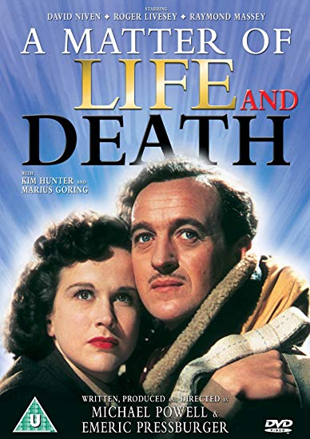
1930s, 1940s

Slide 75
1950s, 1960s

Slide 76
1970s, 1980s

Slide 77
1990s to now

Slide 78
That’s 52 films.

Slide 79
Only eight were made after 2001, and of those eight there are only two that someone who was born in 2001 would have been old enough to watch in the cinema.

Slide 80
So someone who was born in 2001 would have to have had to have made a conscious effort to search out and watch the films on this list.

Slide 81
Contrast the position of someone born in 1970.

Slide 82
They would have been in a position to watch all of the films in the ‘1990s to now’ list as they came out in the cinema.

Slide 83
And watching all of the other films would have been no problem as they were regularly shown on TV in the 1970s and 1980s, when there was very little else to watch on TV.

Slide 84
So someone who was born in 1970 is far more likely to be film literate than someone born in 2001.

Slide 85
Once again, the problem of time gets in the way of someone who was born in 2001 becoming an intellectual.

Slide 86
Let’s now talk about the problem of volume.

Slide 87
Here are some pre-20th century thinkers who any intellectual should know about.

Slide 88
Plato
428 BC – 347 BC
Aristotle
384 BC – 324 BC
Blaise Pascal
1623 – 1662
John Locke
1632 – 1704
Adam Smith
1723 – 1790
Immanuel Kant
1724 – 1804
John Stuart Mill
1806 – 1873
Friedrich Nietzsche
1844 – 1900

Slide 89
It would be unreasonable to expect a teenager to read anything written by these thinkers.

Slide 90
But you should certainly be aware of why they are important thinkers.

Slide 91
Here are some intellectual books by 20th century thinkers that you could read as a teenager.

Slide 93
And here are some intellectual novels/plays/ poems/histories by pre-20th century writers that you could read as a teenager.

Slide 95
And the same from 20th century writers.

Slide 97
As for music, intellectual music tends to be classical music and dominated by the five giants: Bach, Mozart, Beethoven, Schubert, and Wagner.

Slide 98
Here are some pieces by these giants that you could listen to as a teenager.

Slide 102
And some by other composers.

Slide 104
That is a lot to read, listen to, and find out about.

Slide 105
That is the problem of volume: becoming an intellectual requires you to master a lot of material.

Slide 106
So these are the three problems in the way of your becoming an intellectual (assuming the person reading this is a teenager).

Slide 107
The importance of exams and the way they are marked means that the work you do to prepare for exams is unlikely to prepare you to be an intellectual.

Slide 108
It is far harder for someone born in 2001 to become an intellectual than someone like me, who was born in 1970.

Slide 109
And becoming an intellectual requires you to cover a very large terrain of knowledge, books, music, and films.

Slide 110
So how can we get round these problems?

Slide 111
First, start today. The challenge involved in becoming an intellectual is big and the time available to meet it is very limited.

Slide 112
So don’t wait to get started – start today.

Slide 113
Second, use your time efficiently, so that you maximise your opportunities for growth as an intellectual within the time available.

Slide 114
Search out books and materials that will serve as portals – introducing you to a huge range of ideas and knowledge in as few pages as possible. (Without dumbing down.)

Slide 115
The ‘Start Reading Now!’ poster on the Pre-U reading section of my mcbridesguides.com website sets out a number of these portals. Use them, or something like them.

Slide 116
Read magazines and journals that carry reviews of intellectual books.

Slide 117
Reading book reviews of intellectual books is a very efficient way of finding out a huge amount of information very quickly.

Slide 118
But remember: being an intellectual doesn’t stop you being an idiot.
Nassim Nicholas Taleb @nntaleb
Twitter, June 25 2016

Slide 119
So read book reviews written by intellectuals with care, and watch out for any spin or bias that is affecting their writing.

Slide 120
Third, never get discouraged by the challenge involved in becoming an intellectual.

Slide 121
If you do just a small part of what I am recommending, that’s better than nothing.

Slide 122
So try not to think of the big picture – just focus on what would be good to read, watch, listen to, find out about today. And let everything else take care of itself.

Slide 123
Fourth, remember that while you may be subject to certain disadvantages in becoming an intellectual, you also have advantages.

Slide 124
Thanks to the Internet, you are living at a time when a huge amount of what you need to become an intellectual is freely available.

Slide 125
You just need to know what to look for.

Slide 126
And you also live in a time blessed with an embarrassment of riches...

Slide 127
...in terms of books that seek to introduce you to the worlds of ideas and knowledge that you need to be familiar with to become an intellectual.

Slide 128
So explore bookshops and libraries looking for these portals, and make the most of them when you find them.

Slide 129
The End and – I hope – The Beginning

